Slide 1
Chapter 7
Digital Design and Computer Architecture, 2nd Edition
David Money Harris and Sarah L. Harris

Slide 2
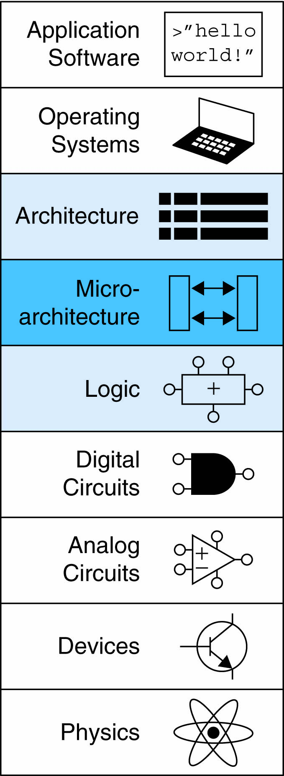
Chapter 7 :: Topics
Introduction
Performance Analysis
Single-Cycle Processor
Multicycle Processor
Pipelined Processor

Slide 3
Multicycle MIPS Processor
Single-cycle:
+ simple
cycle time limited by longest instruction (lw)
2 adders/ALUs & 2 memories
Multicycle:
+ higher clock speed
+ simpler instructions run faster
+ reuse expensive hardware on multiple cycles
- sequencing overhead paid many times
Same design steps: datapath & control

Slide 4
Multicycle State Elements
Replace Instruction and Data memories with a single unified memory – more realistic

Slide 5
Multicycle Datapath: Instruction Fetch
STEP 1: Fetch instruction
The instruction is stored in an Instruction register
IRWrite is asserted when updating a new instruction.

Slide 6
Multicycle Datapath: lw Register Read
STEP 2a: Read source operands from RF
Read the source register (rs field), Instr_{25:21}, into RD1
The value of RD1 is stored in a register A

Slide 7
Multicycle Datapath: lw Immediate
STEP 2b: Sign-extend the immediate
The offset Instr_{15:0} is signed extended to be 32 bits

Slide 8
Multicycle Datapath: lw Address
STEP 3: Compute the memory address
The address of load is the sum of the base address and offset
ALUResult is stored in a register ALUOut

Slide 9
Multicycle Datapath: lw Memory Read
STEP 4: Read data from memory
Load the data from the calculated address in the memory.
A MUX (lorD) to choose the memory address either from the PC or ALUOut
lorD is to indicate an instruction or data address
Data from the memory is stored in a register, Data.

Slide 10
Multicycle Datapath: lw Write Register
STEP 5: Write data back to register file
The data is written back to the register file.
The destination is specified by the rt field of the instruction, Instr_{20:16}

Slide 11
Multicycle Datapath: Increment PC
STEP 6: Increment PC
ALUSrcA chooses either the PC or register A as SrcA
ALUSrcB chooses either 4 or SignImm as SrcB

Slide 12
Multicycle Datapath: sw
Write data in rt to memory
Read base address and sign-extends the immediate
ALU adds the base address to the immediate
rt field, Instr_{20:16}, is connected to the second port of the register file, stored in Register B
The data in B is sent to the WD port of the data memory to be written
MemWrite controls if the write should occur

Slide 13
Multicycle Datapath: R-Type
Read from rs and rt
Write ALUResult to register file
Write to rd (instead of rt)

Slide 14
Multicycle Datapath: beq
rs == rt?
(sign-extended immediate << 2) + (PC+4)

Slide 15
Single-cycle vs. Multicycle
Multicycle:
The instruction is executed in several steps.
Registers are inserted to hold the results of each step.
The ALU is used several times, saving the cost of extra adders.
The instruction and data are stored in one shared memory

Slide 16
Multicycle Processor

Slide 17
Multicycle Control

Slide 18
Main Controller FSM: Fetch
Fetch the instruction from memory at the address held in the PC.
Write the instruction into the instruction register,
meanwhile, update PC by incrementing 4

Slide 19
Main Controller FSM: Fetch
Fetch the instruction from memory at the address held in the PC.
lorD = 0
IRWrite
Write the instruction into the instruction register

Slide 20
Main Controller FSM: Fetch
Update PC’ = PC + 4
ALUSrcA =0
ALUSrcB =01
ALUOp =00
PCSrc = 0
PCWrite
Update new PC’

Slide 21
Main Controller FSM: Fetch

Slide 22
Main Controller FSM: Decode
Examine the opcode of the instruction
The immediate is sign-extended
No control signals

Slide 23
Main Controller FSM: Address
If lw or sw, compute the effective address by adding the base address to the sign-extended immediate.
Store the result into the ALUOut reigster

Slide 24
Main Controller FSM: Address

Slide 25
Main Controller FSM: lw
S3: MemRead
If the instruction is lw, the processor must read data from memory and write it to the register file.
lorD = 1 to select the memory address saved in ALUOut

Slide 26
Main Controller FSM: lw
S4: Mem Writeback
Data is written to the register file.
MemtoReg = 1 to select Data,
RegDst = 0 to pull the destination register from the rt field
RegWrite is asserted to perform the write

Slide 27
Main Controller FSM: sw
If the instruction is sw, the data read from the second port of the register file is written to memory
lorD = 1 to select the address computed in S2
MemWrite is asserted to write the memory

Slide 28
Main Controller FSM: R-Type
S6: Execute
If opcode indicates R-type instruction, calculate the result using the ALU and write the result to the register file.

Slide 29
Main Controller FSM: R-Type
S7: ALU Writeback
ALUOut is written to the register file,
RegDst = 1, destination register is in the rd field
MemtoReg = 0, write data WD3 comes from ALUOut
RegWrite is asserted to write the register file

Slide 30
Main Controller FSM: beq
For beq instructions, the processor calculates the destinations address and compare two source registers

Slide 31
Multicycle Controller FSM

Slide 32
Extended Functionality: addi

Slide 33
Main Controller FSM: addi

Slide 34
Extended Functionality: j

Slide 35
Main Controller FSM: j

Slide 36
Main Controller FSM: j

Slide 37
Multicycle Processor Performance
Instructions take different number of cycles:
3 cycles: beq, j
4 cycles: R-Type, sw, addi
5 cycles: lw
CPI is weighted average
SPECINT2000 benchmark:
25% loads
10% stores
11% branches
20% jumps
52% R-type

Slide 38
Multicycle Processor Performance
Instructions take different number of cycles:
3 cycles: beq, j
4 cycles: R-Type, sw, addi
5 cycles: lw
CPI is weighted average
SPECINT2000 benchmark:
25% loads
10% stores
11% branches
20% jumps
52% R-type
Average CPI = (0.11 + 0.2)(3) + (0.52 + 0.10)(4) + (0.25)(5) = 4.12

Slide 39
Multicycle Processor Performance
Multicycle critical path:
T_{c} = t_{pcq} + t_{mux} + max(t_{ALU} + t_{mux}, t_{mem}) + t_{setup}

Slide 40
Multicycle Performance Example
Element | Parameter | Delay (ps)
Register clock-to-Q | t_{pcq_PC} | 30
Register setup | t_{setup} | 20
Multiplexer | t_{mux} | 25
ALU | t_{ALU} | 200
Memory read | t_{mem} | 250
Register file read | t_{RFread} | 150
Register file setup | t_{RFsetup} | 20
T_{c} = ?

Slide 41
Multicycle Performance Example
Element | Parameter | Delay (ps)
Register clock-to-Q | t_{pcq_PC} | 30
Register setup | t_{setup} | 20
Multiplexer | t_{mux} | 25
ALU | t_{ALU} | 200
Memory read | t_{mem} | 250
Register file read | t_{RFread} | 150
Register file setup | t_{RFsetup} | 20
T_{c} = t_{pcq_PC} + t_{mux} + max(t_{ALU} + t_{mux}, t_{mem}) + t_{setup}
= t_{pcq_PC} + t_{mux} + t_{mem} + t_{setup}
= [30 + 25 + 250 + 20] ps
= 325 ps

Slide 42
Chapter 7 :: Topics
For a program with 100 billion instructions executing on a multicycle MIPS processor
CPI = 4.12
T_{c} = 325 ps
Execution Time =

Slide 43
For a program with 100 billion instructions executing on a multicycle MIPS processor
CPI = 4.12
T_{c} = 325 ps
Execution Time = (# instructions) × CPI × T_{c}
= (100 × 10⁹)(4.12)(325 × 10⁻¹²)
= 133.9 seconds
This is slower than the single-cycle processor (92.5 seconds). Why?

Slide 44
Multicycle Performance Example
Program with 100 billion instructions
Execution Time = (# instructions) × CPI × T_{c}
= (100 × 10⁹)(4.12)(325 × 10⁻¹²)
= 133.9 seconds
This is slower than the single-cycle processor (92.5 seconds). Why?
Not all steps same length
Sequencing overhead for each step (t_{pcq} + t_{setup}= 50 ps)

Slide 45
Review: Single-Cycle Processor

Slide 46
Review: Multicycle Processor

Slide 47
Pipelined MIPS Processor
Temporal parallelism
Divide single-cycle processor into 5 stages:
Fetch
Decode
Execute
Memory
Writeback
Add pipeline registers between stages

Slide 48
Single-Cycle vs. Pipelined
Throughput is 1 instruction per 950ps
Throughput is 1 instruction per 250ps

Slide 49
Pipelined Processor Abstraction

Slide 50
Single-Cycle & Pipelined Datapath
There is an error in the Figure

Slide 51
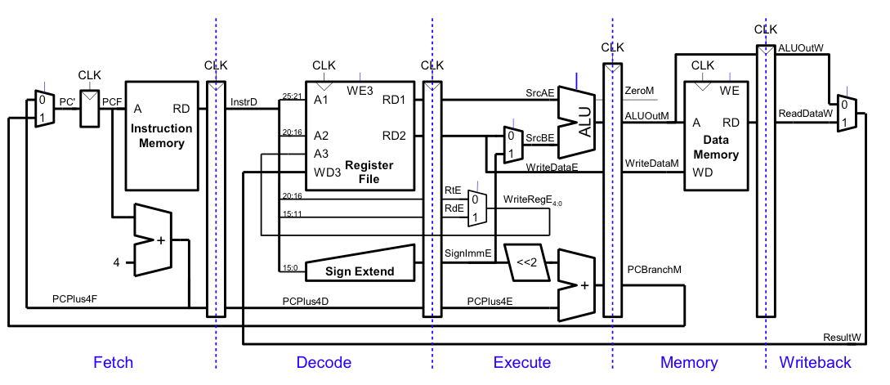
Pipelined Datapath
At cycle 5, the result of lw would be incorrectly written to $s4 rather $s2

Slide 52
Corrected Pipelined Datapath
WriteReg must arrive at same time as Result

Slide 53
Pipelined Processor Control
Same control unit as single-cycle processor
Control delayed to proper pipeline stage

Slide 54
Pipeline Hazards
When an instruction depends on result from instruction that hasn’t completed
Types:
Data hazard: register value not yet written back to register file
Control hazard: next instruction not decided yet (caused by branches)

Slide 55
Data Hazard

Slide 56
Handling Data Hazards
Insert nops in code at compile time
Rearrange code at compile time
Forward data at run time
Stall the processor at run time

Slide 57
Compile-Time Hazard Elimination
Insert enough nops for result to be ready
Or move independent useful instructions forward

Slide 58
Data Forwarding
Read after write (RAW) hazard
In cycle 4, $s0 is forwarded from the memory stage of the add instruction to the Execute stage
In cycle 5, $s0 is forwarded from the writeback stage to the execute stage of the or instruction

Slide 59
Data Forwarding

Slide 60
Data Forwarding
Forward to Execute stage from either:
Memory stage or
Writeback stage
Forwarding logic for ForwardAE:
if ((rsE != 0) AND (rsE == WriteRegM) AND RegWriteM)
then ForwardAE = 10
else if ((rsE != 0) AND (rsE == WriteRegW) AND RegWriteW)
then ForwardAE = 01
else ForwardAE = 00
Forwarding logic for ForwardBE same, but replace rsE with rtE

Slide 61
Stalling
lw instruction has a 2-cycle latency
lw instruction receives data from memory at the end of cycle 4
But and instruction needs that data at the beginning of cycle 4
-> stall the pipeline

Slide 62
Stalling
In cycle 5, the result can be forwarded to the execute stage of and.
Unused stage propagates through the pipeline is called a bubble.

Slide 63
Stalling Hardware

Slide 64
Stalling Logic
If it is lw and its destination register (rtE) matches source operand in the Decode stage (rsD or rtD), then the instruction is stalled. MemtoRegE is asserted for lw instruction.
lwstall =
((rsD==rtE) OR (rtD==rtE)) AND MemtoRegE
When a lw stall occurs, StallD and StallF are asserted to hold their old values.
FlushE is asserted to clear the content of Execute stage
StallF = StallD = FlushE = lwstall

Slide 65
Control Hazards
beq:
branch not determined until 4th stage of pipeline
Instructions after branch fetched before branch occurs
These instructions must be flushed if branch happens
Branch misprediction penalty
number of instruction flushed when branch is taken
May be reduced by determining branch earlier

Slide 66
Control Hazards: Original Pipeline

Slide 67
Control Hazards
Flushing so many instructions when the branch is taken degrades performance
-> use an equality comparator (instead of subtraction and zero detection

Slide 68
Early Branch Resolution
Equality comparator added; PCBranch is moved to Decode stage

Slide 69
Early Branch Resolution
Introduced another data hazard in Decode stage (RAW data hazard)

Slide 70
Early Branch Resolution

Slide 71
Handling Data & Control Hazards

Slide 72
Control Forwarding & Stalling Logic
Forwarding logic:
ForwardAD = (rsD !=0) AND (rsD == WriteRegM) AND RegWriteM
ForwardBD = (rtD !=0) AND (rtD == WriteRegM) AND RegWriteM
Stalling logic:
branchstall = BranchD AND RegWriteE AND
(WriteRegE == rsD OR WriteRegE == rtD)
OR
BranchD AND MemtoRegM AND
(WriteRegM == rsD OR WriteRegM == rtD)
StallF = StallD = FlushE = lwstall OR branchstall

Slide 73
Branch Prediction
Guess whether branch will be taken
Backward branches are usually taken (loops)
Consider history to improve guess
Good prediction reduces fraction of branches requiring a flush

Slide 74
Pipelined Performance Example
SPECINT2000 benchmark:
25% loads
10% stores
11% branches
2% jumps
52% R-type
Suppose:
40% of loads used by next instruction
25% of branches mispredicted
All jumps flush next instruction
What is the average CPI?

Slide 75
Pipelined Performance Example
SPECINT2000 benchmark:
25% loads
10% stores
11% branches
2% jumps
52% R-type
Suppose:
40% of loads used by next instruction
25% of branches mispredicted
All jumps flush next instruction
What is the average CPI?
Load/Branch CPI = 1 when no stalling, 2 when stalling
CPI_{lw} = 1(0.6) + 2(0.4) = 1.4
CPI_{beq} = 1(0.75) + 2(0.25) = 1.25
Average CPI = (0.25)(1.4) + (0.1)(1) + (0.11)(1.25) + (0.02)(2) + (0.52)(1)
= 1.15

Slide 76
Pipelined Performance
Pipelined processor critical path:
T_{c} = max {
t_{pcq} + t_{mem} + t_{setup}
2(t_{RFread} + t_{mux} + t_{eq} + t_{AND} + t_{mux} + t_{setup} )
t_{pcq} + t_{mux} + t_{mux} + t_{ALU} + t_{setup}
t_{pcq} + t_{memwrite} + t_{setup}
2(t_{pcq} + t_{mux} + t_{RFwrite}) }

Slide 77
Pipelined Performance Example
Element | Parameter | Delay (ps)
Register clock-to-Q | t_{pcq_PC} | 30
Register setup | t_{setup} | 20
Multiplexer | t_{mux} | 25
ALU | t_{ALU} | 200
Memory read | t_{mem} | 250
Register file read | t_{RFread} | 150
Register file setup | t_{RFsetup} | 20
Equality comparator | t_{eq} | 40
AND gate | t_{AND} | 15
Memory write | T_{memwrite} | 220
Register file write | t_{RFwrite} | 100 ps
T_{c} = 2(t_{RFread} + t_{mux} + t_{eq} + t_{AND} + t_{mux} + t_{setup} )
= 2[150 + 25 + 40 + 15 + 25 + 20] ps = 550 ps

Slide 78
Pipelined Performance Example
Program with 100 billion instructions
Execution Time = (# instructions) × CPI × T_{c}
= (100 × 10⁹)(1.15)(550 × 10⁻¹²)
= 63 seconds

Slide 79
Processor Performance Comparison
Processor | Execution Time (seconds) | Speedup (single-cycle as baseline)
Single-cycle | 92.5 | 1
Multicycle | 133 | 0.70
Pipelined | 63 | 1.47

Slide 80
Other Resources
Patterson & Hennessy’s: Computer Architecture: A Quantitative Approach
Conferences:
www.cs.wisc.edu/~arch/www/
ISCA (International Symposium on Computer Architecture)
HPCA (International Symposium on High Performance Computer Architecture)

